Slide 1
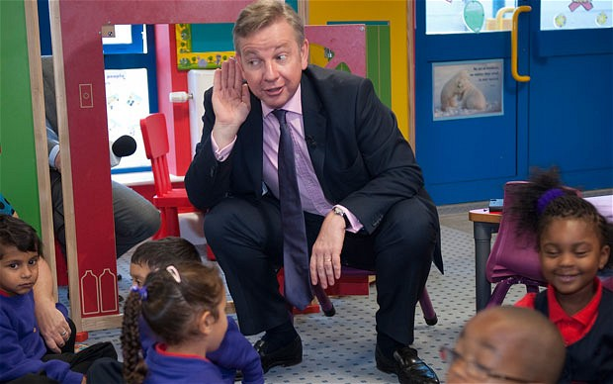
Is Michael Gove doing the right thing?

Slide 2



ICT education needs to change to stay relevant in an increasingly technological and computer-driven world. We must give our children the skills to understand and control it rather than be controlled by it.

Slide 3

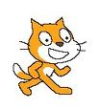

Children need to know more than how to use basic desktop applications.
They increasingly need to understand how computers work.

Slide 4


My Scratch project
Curriculum area: Science “Life Processes and Living Things”
Target audience: Early KS2 (7-9 years)
Suggested context: 10 minute plenary to consolidate the learning of a session.

Slide 5




Challenges
Timings
Walking
Waiting around
I sometimes felt like this…

Slide 6
Application in schools
1. As a teaching resource. To enrich lessons with engaging, visual and interactive interludes.
Pros
Stimulating and promotes talk.
Targets visual and auditory learning styles.
Can contextualise abstract themes.
Children love it!
Cons
Time consuming to create.
Does it do anything that Youtube cannot?

Slide 7



The children’s reaction to seeing Scratch for the first time.

Slide 8
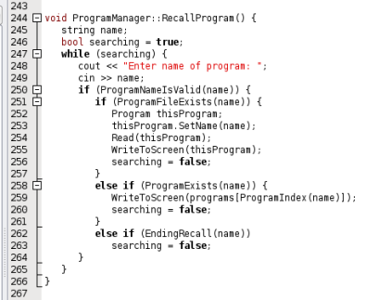
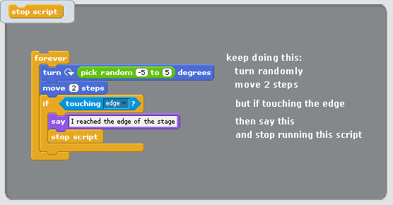
Application in schools
2. A starting point for implementing Michael Gove’s vision for the future of ICT education in primary schools.
Scratch enables even young children to engage, in a very real sense, with the process of computer programming without even realising they are doing so. The process is creative, collaborative, cross-curricular and fun.

Slide 9
Good practice in schools
Link it to a curriculum topic being studied.
Paired work.
Start with small, achievable objectives.
  Give children more autonomy over their work once their confidence with the software is established.
Let the children teach each other. A problem shared is a problem halved!
Celebrate their achievements.

Slide 10
Scratch workshop
“Dads do IT”

Slide 11
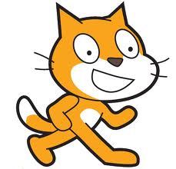
Eton Porny C of E First School
Dads do IT!
Friday 14th June 2013
We are celebrating Father’s Day with a special event to challenge all dads to make IT happen!
Are you a dad who has a passion for computers?
Do you want to find out more about the latest education software?
We will be exploring SCRATCH, an innovative, visual, tile-based programming tool which provides an introduction to programming for children.
Make characters move across the screen and talk to each other.
Please inform the office if you are able to join us for a day of computer challenges.

