Slide 1
Literacy from scratch
Trainee Teacher

Slide 2
Background: What is Literacy from scratch?
Literacy from Scratch is a response to the UK’s governments demand to teach children from the ages of 5-11 programming skills
The program is designed for children to teach them basic methods of Algorithms and coding
The program is quite simple to use for designing games to creating their own narrative and other cross curricular themed activities
Children can create various backgrounds, use sprites, download/upload music from files
By applying this knowledge to create games, debug etc. children will have the opportunity to learn a programming language
Create programs for certain audiences
Children can use variety of other software by integrating it into this program
It is ‘free to download’. Currently it is being used in European countries – it has made its way from the USA

Slide 3
who is it aimed at?
National Curriculum links
Interactive music game. Children to connect the sound to the object, by answering sequence of questions. Then find the instrument.
Children to touch the screen to connect the instrument to the sounds.
Once the Children have found the instrument, they’re to create their own sounds by and chant song.
Provide children with songs related to phonics for example d-r-u-m (it has for sounds) or get children to clap.
Use picture cues for SEND/EMA to help them to locate the right instruments
Computing
Year 1
Musical Instruments Interactive Game
Chn to recognise common instrument sounds-NC
NC-Chn will recognise the instrument by listening with concentration-NC
Experiment with and create select and combine sounds-NC
Chn will incorporate all elements use algorithms
Create debug simple program
Predict the behaviour of simple programs-NC
Play tuned and untuned instruments musically-NC

Slide 4
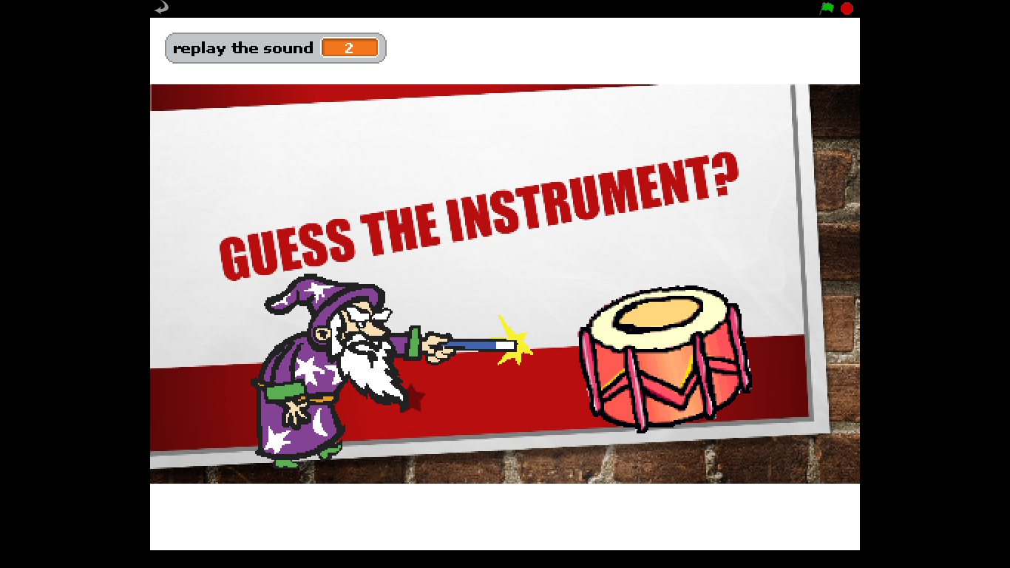
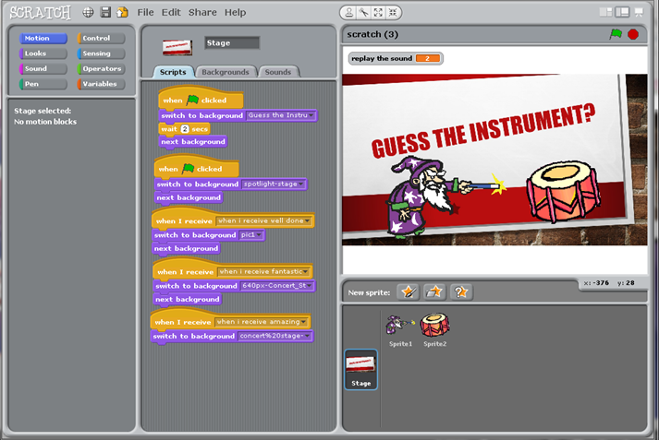
The project
Project primarily designed to support pupils to incorporate music by using computing.
A screen shot of type background children can create.
Add in captions/titles, movements, music etc.
Background instructions can be added in by children

Slide 5
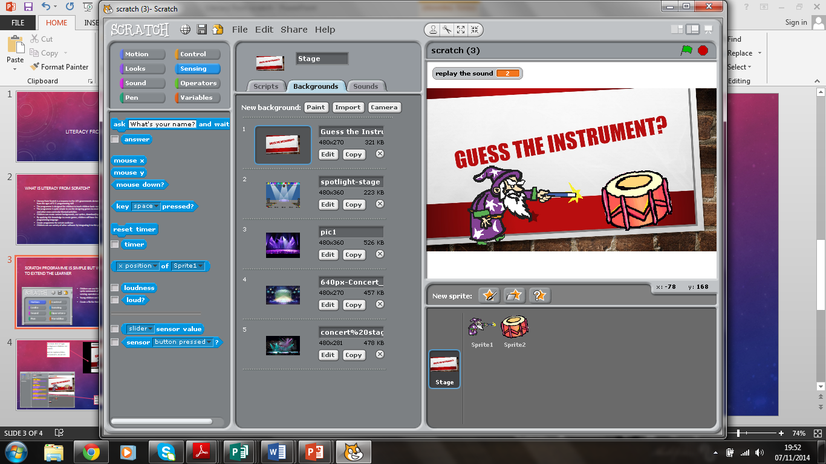
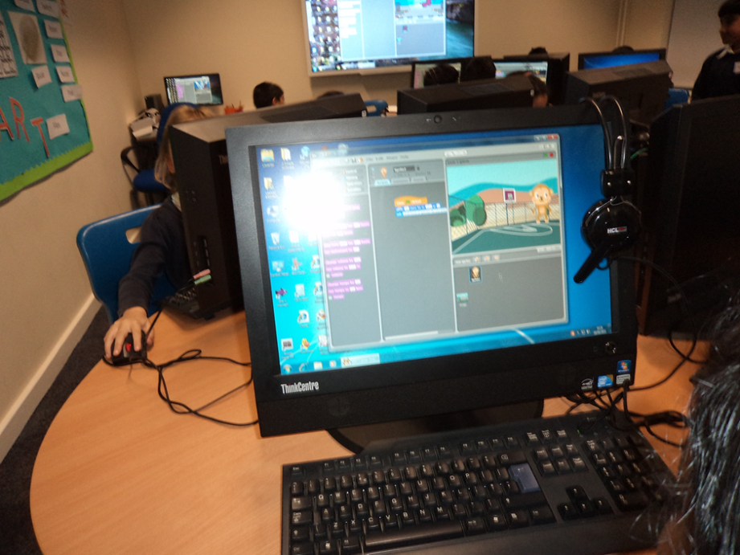
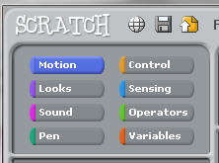
PURPOSE: Scratch programme is simple but with a scope to extend the learner
Children were able to use this control panel to give their sprite commands of movement, looks, sounds, sensing, operators and variables
children learnt how to save their work
Create a file for their learning
Papert's ideas about children learning with computers: "learning-by-making" (Papert & Harel, 1991), "technology as building material, hard fun, learning to learn, taking time – the proper time for the job, You can’t get it right without getting it wrong, Do unto ourselves what we do unto our students" (Stager, 2007)

Slide 6
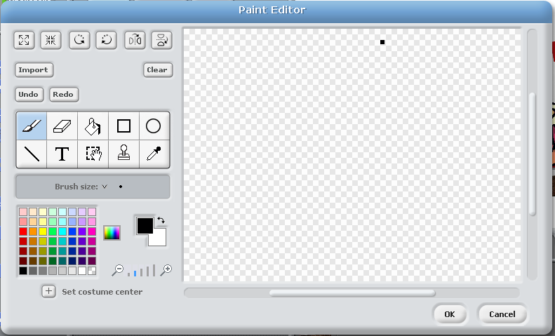
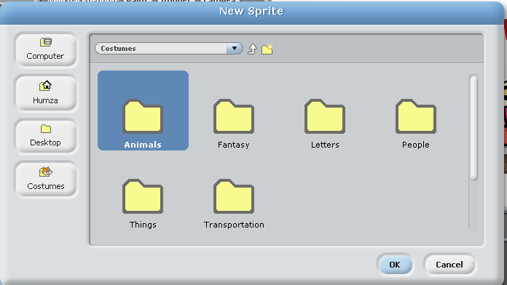
Children have been able to incorporate other software mediums such as Paint, Microsoft Office
Some children found it difficult to create their own sprites, therefore they were encouraged to use ready made costumes.

Slide 7
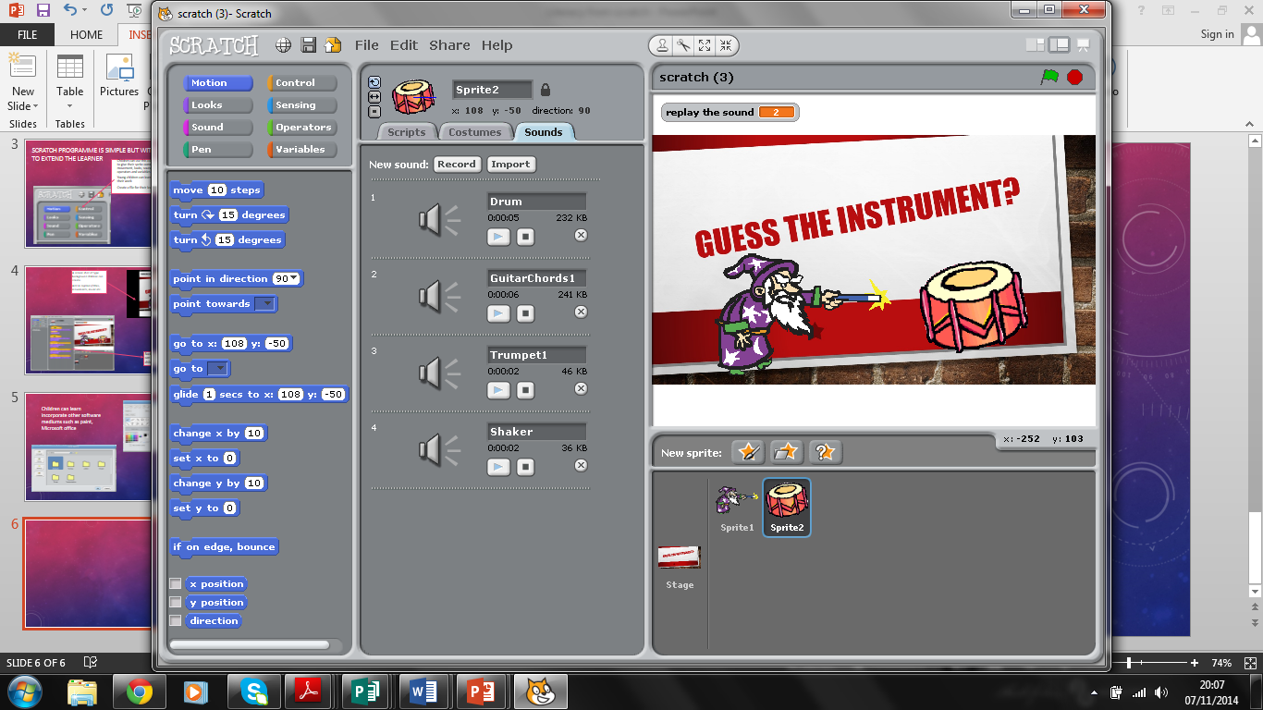
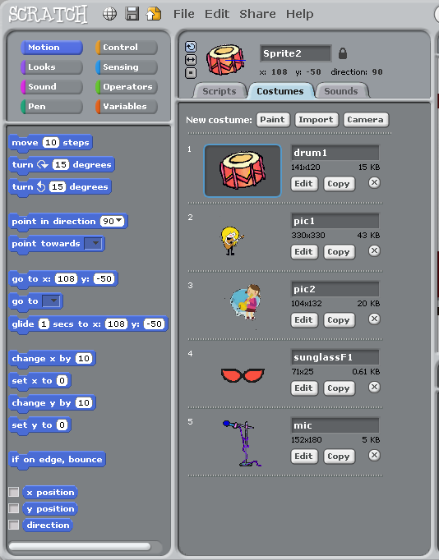
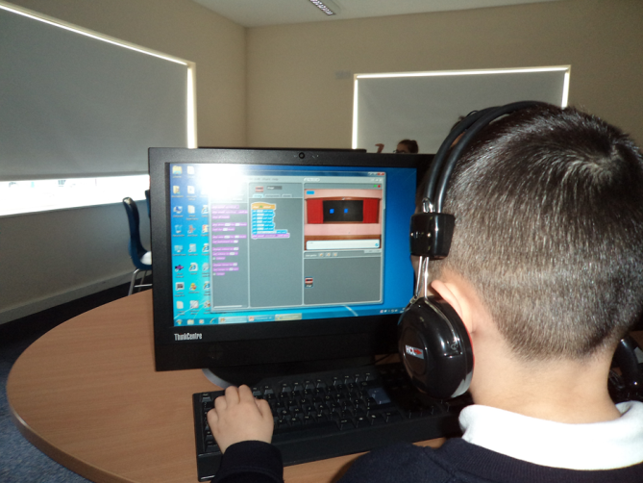
Scratch can be used for variety of different audiences
Music can be created, uploaded/downloaded by either recorded or imported
Sprites can be either created or imported or pictures can be taken by the camera
Sprites can be adjusted to suit the purpose

Slide 8
What effect has this project had on the school(s) in which you have worked?
The project has worked extremely well in both schools, that I was placed.
Inset
Assess pupils
Help pupils to create their own project
Allow pupils with the opportunities to share ideas through plenaries
Help them to become producers rather then consumers

Slide 9
What ethical considerations surround your project?
No ethical issues
Adult-led but child-initiated approach
Scratch from Literacy – has all inclusive package to eradicate any issues for example cyber-bullying
However, making pupils aware of uploading information that is sensible is crucial
Making sure that pupils are not side tracked to other websites, whilst using Scratch

Slide 10
How can this project develop cross-curricular thinking skills?
Papert's ideas about children learning with computers: "learning-by-making" (Papert & Harel, 1991), "technology as building material, hard fun, learning to learn, taking time – the proper time for the job, You can’t get it right without getting it wrong, Do unto ourselves what we do unto our students" (Stager, 2007)
“To discover and to describe formally the meanings that human beings create out of their encounters with the world, and then to propose hypotheses about what meaning-making processes were implicated" (Bruner 1990, 2).

Slide 11
What have you gained from the project?
Planning creatively
Learnt a new skill set to teach
Able to assess pupils learning
Encourage pupils to become creative thinkers and independent learners by creating
Easy to teach programming to all ages in primary school

Slide 12
References
Bruner, J. (1990). Acts of Meaning. Cambridge, MA: Harvard University Press.
PAPERT, S., HAREL, I. (1991) Situating Constructionism. Available on http://www.papert.org/articles/SituatingConstructionism.html.
STAGER, G. (2007) An Investigation of Constructivism in the Maine Youth Centre. Ph.D. dissertation. University of Melbourne.

