Slide 1
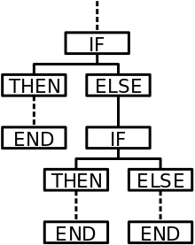
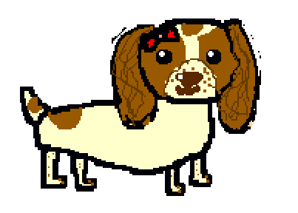
Maisy goes for a walk
Written and illustrated by
Beth Mead
(aged 11)
IF, THEN, ELSE
gives two possible choices (or paths) that a program (or dog!) can follow.
Computer coding concept: IF, THEN, ELSE

Slide 2
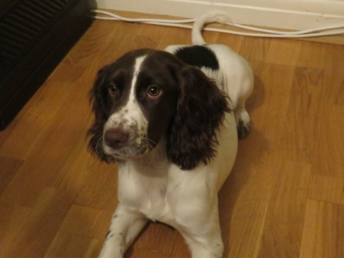
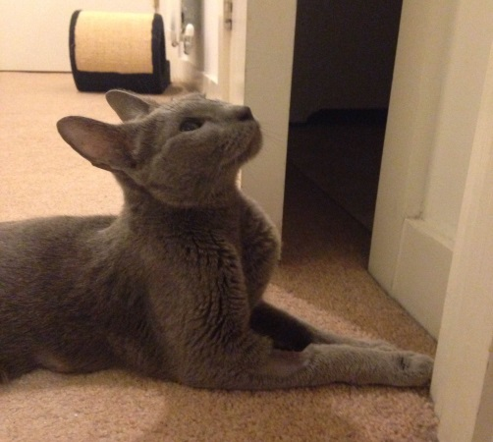
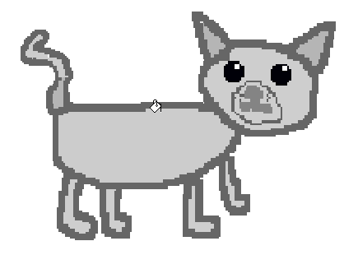
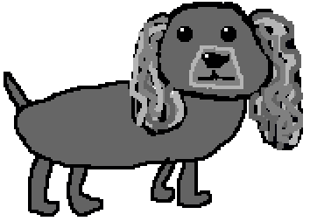
Maisy is a real dog who lives with Beth and her family, in Merton, London.
This is Malika. She is a real cat, who also lives in Merton. She is Beth’s Auntie Justine’s cat.
Storm is a fictional (made up) friend to Maisy.

Slide 3
Maisy woke up. She wanted to go for a walk, so she looked out of the window. If it was a sunny day, then she would go out. If it was not (else) she would stay at home in the warm.

Slide 4

The sun was shining brightly, so she decided to go to the park. She hoped that she would meet some of her friends there.
If she found some friends, then she would play with them. If not (else) she would run around by herself.

Slide 5

To get to the park, Maisy had to cross a busy road. She knew that she needed to be careful. She sat down at the side of the road. She looked carefully to see if there were any cars coming.
If there were any cars, then she would wait. If not (else) she would cross the road.

Slide 6
She really hoped that she would see her friend, Storm, in the park.
If she did, then she would play with him, else she would find another friend to play with, instead.

Slide 7
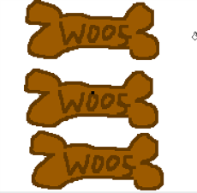
There he was! She decided to ask him home for tea.
If he said “Yes”, then she would give him some of his favourite dog biscuits, else they would both carry on playing in the park.
Perhaps they could make some dog biscuits together. Chicken flavour, or beef?........

Slide 8
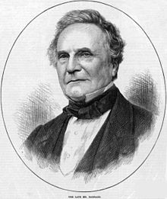
IF, THEN, ELSE, as a computer concept, was first created by Charles Babbage for his early Victorian calculating machine. It was designed to enable his brilliant “Analytical Engine” (1837) to make branching choices.
II
I did get some help with the programming, though, from my good friend, Ada Lovelace.

