Slide 1
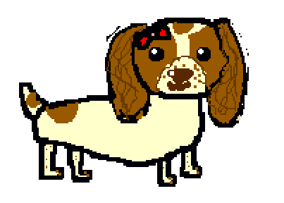
Maisy saves Malika
D
Decomposition in Computing, is breaking a problem into parts that are easier to understand, and program.
Written and illustrated by
Beth Mead
aged nine
(Revised in Year 6)
Computer coding concept: Decomposition

Slide 2
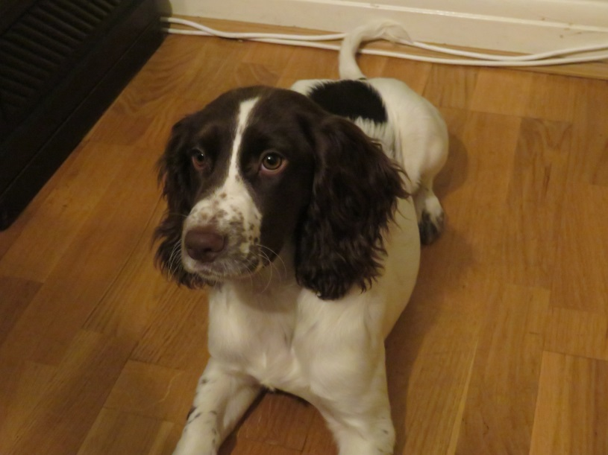
Maisy is a real dog, who lives with Beth in
south London.

Slide 3
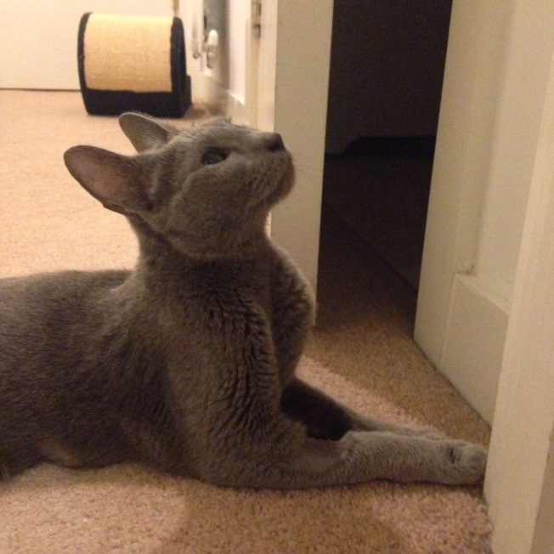
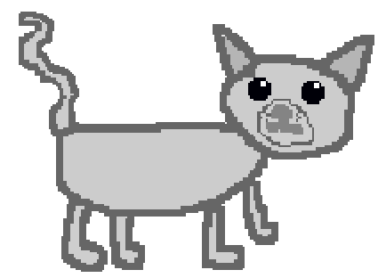
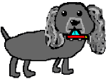
This is Malika, also real. She is a Russian Blue cat. But she is neither Russian, nor blue…..
Storm is a fictional (made up) friend to Maisy.

Slide 4
Maisy and Storm were on a playdate, Maisy asked Malika if she wanted to come.
Hello Malika!

Slide 5
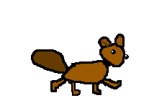

After they had played for a while, Malika went for a walk in the garden. Suddenly, out of nowhere, a squirrel, called Nutty, appeared. Malika was frightened.
Aaargh!
I hate squirrels!
AA
Acorn!

Slide 6

Malika ran up a nearby tree.
AA
I must bury this, randomly, in someone’s lawn.

Slide 7

But, she got stuck in the tree, and could not get down!

Slide 8
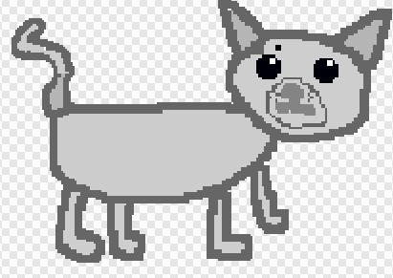
She hoped that if she meowed loudly enough, then Maisy or Storm would hear her, and come to the rescue.

Slide 9
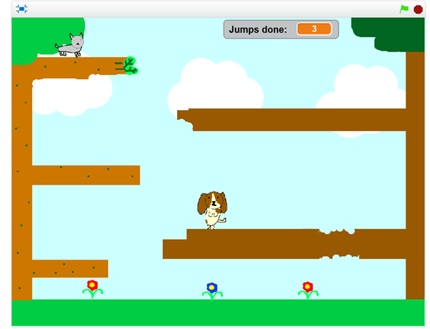
Without stopping to think, Maisy said, “ I will jump up from branch to branch, and save Malika.” But Malika just ran farther up the tree! The first plan had failed.
There is a related Scratch game by Beth for you to play. Using the arrow keys and the space bar, can you get Maisy to jump up to Malika? How many jumps will you take? Try this game with a friend! See who has the lowest jumping score. See:
http://www.worldecitizens.net/resource-materials-supporting-the-lambeth-college-projects/

Slide 10
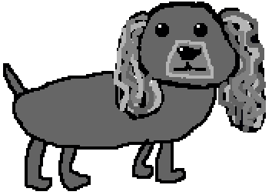
Maisy and Storm realised that they would need to try again, and break the problem down into easy steps, if they were to be able to save Malika.

Slide 11
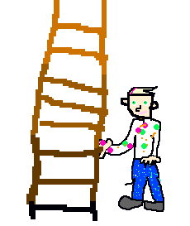
Maisy’s Plan B
These are the new steps:
First, Maisy needed to get the attention of their friendly neighbour. She would do this by barking.
Next, she would get the neighbour to come into the garden.
Then the neighbour would see the problem, and get his wonky ladder.
Finally, he would climb up carefully, and rescue Malika!

Slide 12
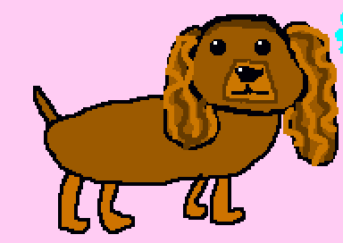
They started barking.
D
Woof!
Woof!

Slide 13
The neighbour saw the problem, brought his wonky ladder, and climbed up to save Malika.

Slide 14
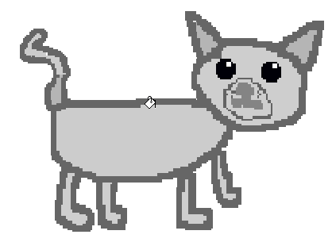
The plan to break the problem down into steps worked!
Thanks Koda!
Thanks, Maisy and Storm!
D
Decomposition is very useful,
sometimes.
Factual note: it can actually save real - life cats, like Margaret's cat, Vickie…..

Slide 15
Decomposition in Computing is breaking a problem into parts that are easier to understand and program.

