Slide 1

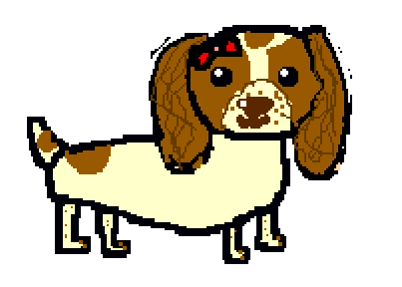
Maisy and Malika make a birthday cake
Written and illustrated by
Beth Mead
(aged 11)
Abstraction means sorting relevant information from unnecessary detail.
Computer coding concept: Abstraction

Slide 2
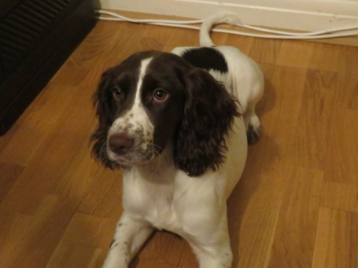
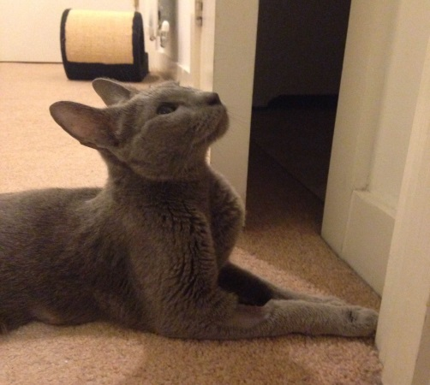
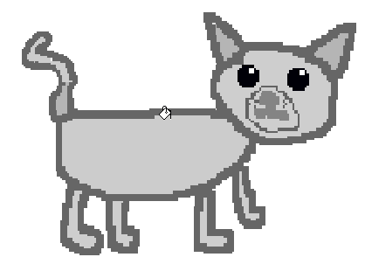
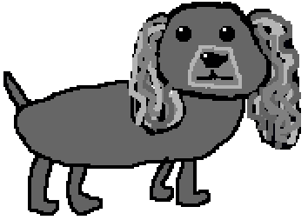
Maisy is a real dog who lives with Beth and her family, in Merton, London.
This is Malika. She is a real cat, who also lives in Merton. She is Beth’s Auntie Justine’s cat.
Storm is a fictional (made up) friend to Maisy.

Slide 3




It was Storm’s birthday, and Maisy was throwing him a surprise party!

Slide 4
Maisy decided to make a chocolate cake for Storm. He loved special dog chocolate.
Maisy asked Malika to help her. She wanted to surprise Storm.

Slide 5
They found a chocolate cake recipe:
5 ounces of margarine, or butter
5 ounces of sugar
2 eggs
6 ounces of chocolate chips
8 ounces of self-raising flour

Slide 6
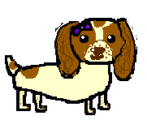

They started to make the cake. Maisy would find the ingredients, and Malika would mix and check the recipe.
5 ounces of margarine or butter
5 ounces of sugar
2 eggs
6 ounces of chocolate chips
8 ounces of self-raising flour

Slide 7
Malika started to mix the cake ingredients.
Should we use margarine OR butter?
It does not matter. They will both work.

Slide 8
However, self-raising flour is vital for the cake to rise, so it is NOT optional.

Slide 9
Malika asked Maisy for some eggs. There were brown-shelled eggs, and white-shelled eggs.
What colour eggs should we use?
It doesn't matter. That’s just the shell colour.

Slide 10


Next, Maisy asked Malika to add the sugar. Again, there was white sugar and brown sugar.
We need sugar, but the colour doesn’t matter. Does it?
The colour only matters if you are making a white sponge, but we are not.

Slide 11
The next ingredient was chocolate chips. Maisy found white and brown chocolate chips.
It doesn’t matter, but I think we should add white chips.
I think we should add brown chips.
Maybe we could add both!

Slide 12
They both realised that some ingredients are vital, while others are optional:
You can use butter OR margarine white OR brown eggs, it does not matter white OR brown sugar, it does not matter white OR brown chocolate chips, OR both….
But self-raising flour is vital for making a cake. Otherwise you end up with biscuits!

Slide 13

It is the same with computer programming: most parts of the program are essential, while other parts can involve choices, which could be left out. Knowing which element is which is important for programming.
OR

Slide 14
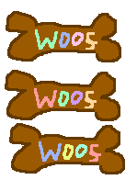
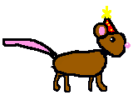
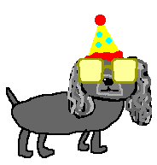
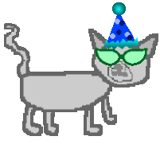
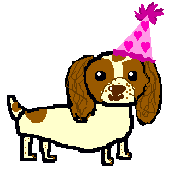
They finished making the cake, and Storm had an amazing party!
And thank you for teaching me what is vital in making a cake.
You’re welcome! And, Malika, I also taught you a process called Abstraction.
Thanks Maisy! This is a brilliant birthday!

Slide 15
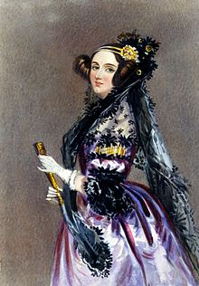
Ada Lovelace (1815 to 1852) worked with Charles Babbage and his Analytic Engine, the first mechanical computer. Her role in this work made her the world’s first computer programmer. There is a modern computer program, Ada, named after her.

